Slide 1

Ames House Price Prediction
Will Han
Gary Lin

Slide 2
Table of Content
Background Information
Exploratory Data Analysis (EDA)
Model Tests
Conclusion & Key Take-Aways

Slide 3
Background Information Ames Housing Data
Housing data from Ames, Iowa
79 explanatory variables describing various aspects of residential homes
Results
Goal: predict the sales price for each house in the test set
Metric: root mean squared error (RMSE) between the logarithm of the predicted value and the logarithm of the observed sales price will be used

Slide 4
Exploratory Data Analysis (EDA) Initial Look at the Data & Feature Creation
1460 observations & 79 features (including sale price)
There were many features that had most of the data in one value
There were many features that had quality metrics (i.e. Poor to Excellent)
Created TotalSF (total square feet of the property) feature by adding the following features:
TotalBsmtSF (total square feet of basement area)
1stFlrSF (first floor square feet)
2ndFlrSF (second floor square feet)

Slide 5
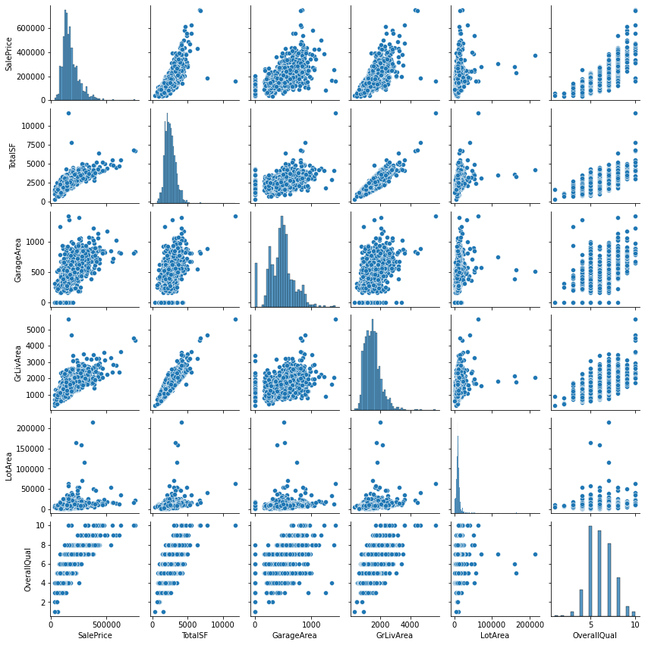
Exploratory Data Analysis (EDA)
Scatter plot of main features:
TotalSF
TotRmsAbvGrd
YearBuilt
LotArea
OverallQual
SalePrice
Removed outliers:
TotalSF > 7,500
LotArea > 10,000

Slide 6
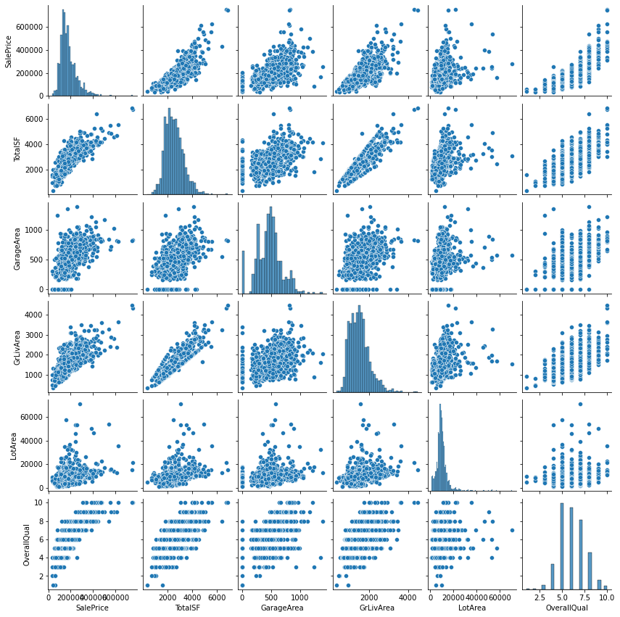
Exploratory Data Analysis (EDA)
Updated scatter plot with outliers removed
Additional checks:
Highly skewed features
Features with no variation

Slide 7
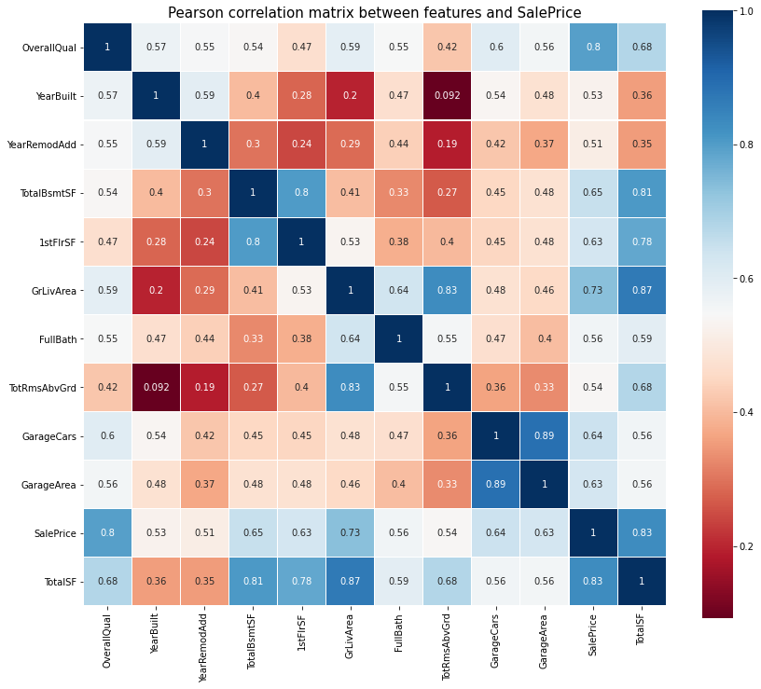
Exploratory Data Analysis (EDA)
Chose features that had a correlation with SalePrice of more than 0.5
All observations seemed very intuitive

Slide 8
Exploratory Data Analysis (EDA) Imputation, Feature Engineering, and Final Cleaning
Imputations:
Imputed missing numerical features using median (by neighborhood?)
Imputed missing categorical features using mode (by neighborhood?)
Feature Engineering:
Used ordinal encoder for ordinal features to capture the relationship between values within the feature
Used target encoding for non-ordinal features
Dropped features where the largest category of the feature encompasses at least 90% of the data

Slide 9
Model Tests Baseline Model & Goal
Models used:
Random Forest Regression
Gradient Boosting Regression
Light Gradient Boosting Machine (LGBM) Regression
Extreme Gradient Boosting (XGB) Regression
Stacked Meta-Learner
5-fold cross validation was used for all models
Tuning hyperparameters using grid search & Bayesian optimization (hyperopt) for all models
The goal is to find a model that minimizes RMSE of logarithm of sale price

Slide 10
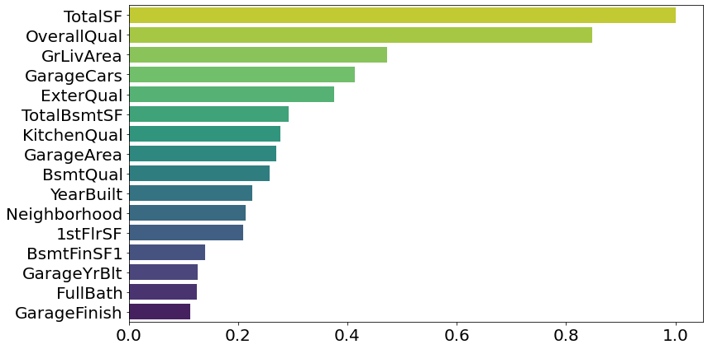
Model Tests (Random Forest)
Advantages:
Reduce overfitting
Handles categorical & numerical features
Handles nonlinearity
Weaknesses:
Suffers a lack of interpretability
Less efficient
RMSE: 0.141889

Slide 11
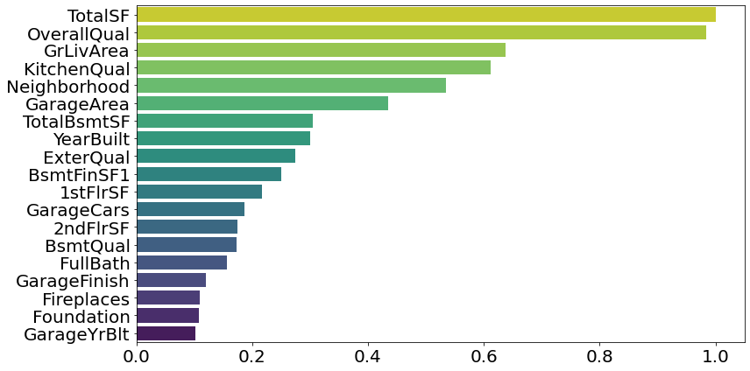
Model Tests (Gradient Boosting)
Advantages:
Performs optimization in function space
Weaknesses
Sensitive to overfitting on noisy data
RMSE: 0.115635

Slide 12
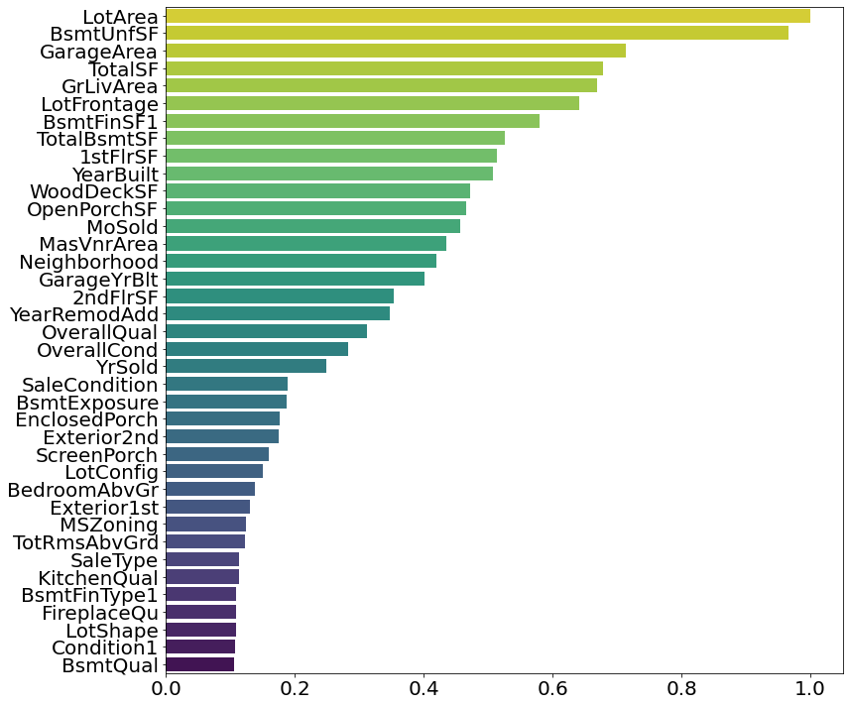
Model Tests (Light GBM)
Advantages:
Grows trees leaf-wise
Efficiency
Memory consumption
RMSE: 0.119103

Slide 13
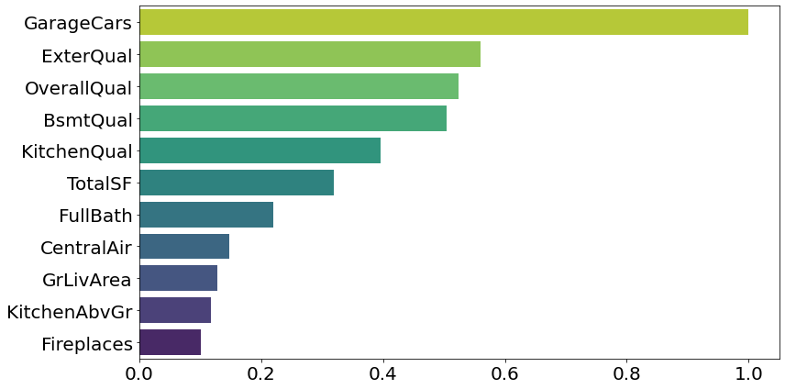
Model Tests (XGBoost)
Advantages:
Uses gradient boosting trees as the error predictor
Works well with small or big data
Prevents overfitting
RMSE: 0.112655

Slide 14
Model Tests Extra Tests
Tested more models to see if any results in a RMSE lower than 0.112655 from XGBoost
Remove Less Important Features
Tested XGBoost with a restricted feature set
RMSE was 0.116393, which is higher than XGBoost
Meta-Learn
Stacked regressor had RMSE of 0.117099, which is higher than XGBoost
Voting regressor (weighted average) had RMSE of 0.114312, which is higher than XGBoost

Slide 15
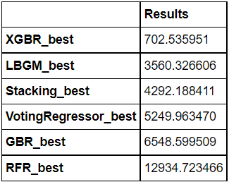
Model Tests Final Dollar Difference & Kaggle Score
Dollar differences were calculated for each models on the training data set
As expected, XGBoost produced the best result
Kaggle Score: SCORE

Slide 16
Conclusion & Key Take-Aways
Recommendations to home sellers and/or buyers using the model with the best RMSE result (XGBoost):
Add value to the following categories:
Garage car capacity
External Quality
Overall Quality
Basement Quality
Kitchen Quality
Look at those fields in the data and get more insights

Slide 17
Thank you!

